Slide 1

TUGAS KELOMPOK 5 DATABASE TECHNOLOGY
JANUARI 13, 2023

Slide 2




















ANGGOTA
1. Reihan Wilbert 2502009526
2. Renaldo Robert Sanjaya 2501987186
3. William Syaputra 2501987431
4. Alvin Akira 2502008486
5. Yonatan Sie 2501998523
6. I Made Danendra Widyatama 2502001826
7. Michael Surya 2501995912

Slide 3
OrderID : RB-162756-8335312
OrderDate : 12/5/2022
OrderDay : Monday
CustomerName : Fepri Putra
DriverName : Ahmad Sobari
PlatNumber : B 4126 NIM
MotorcycleBrand : Honda
ModelVersion : Vario
Distance : 6.5 KM
TripDuration : 32 Mins
PickupTime : 07.23
PickupAddress : Jl. Mawar 3 Blok C3 No 5
ArrivedTime : 07.56
Destination : Stasiun MRT Lebak Bulus
DestinationAddress : Jl. Lebak Bulus Raya No.5
TripFare : Rp 21.000
PlatformFee : Rp 2.000
TotalPayment : Rp 23.000
PaymentMethod : GoPay
TotalPaid : Rp. 23.000
UNF
Unormalised Form

Slide 4
TrTransactionHeader
OrderID(PK) : RB-162756-8335312
OrderDate : 12/5/2022
OrderDay : Monday
CustomerName : Fepri Putra
CustomerEmail :
CustomerPhone :
DriverName : Ahmad Sobari
DriverEmail :
DriverPhone :
PlatNumber : B 4126 NIM
MotorcycleBrand : Honda
ModelVersion : Vario
Distance : 6.5 KM
PickupTime : 07.23
PickupAddress : Jl. Mawar 3 Blok C3 No 5
ArrivedTime : 07.56
Destination : Stasiun MRT Lebak Bulus
DestinationAddress : Jl. Lebak Bulus Raya No.5
PaymentMethod : GoPay
1NF
First Normalised Form
TrTransactionDetail
OrderID(PK, FK) : RB-162756-8335312
TripFare : Rp21,000
PlatformFee : Rp2,000

Slide 5
TrTransactionHeader
OrderID(PK) : RB-162756-8335312
OrderDate : 12/5/2022
OrderDay : Monday
CustomerName : Fepri Putra
CustomerEmail :
CustomerPhone :
DriverName : Ahmad Sobari
DriverEmail :
DriverPhone :
PlatNumber : B 4126 NIM
MotorcycleBrand : Honda
ModelVersion : Vario
Distance : 6.5 KM
PickupTime : 07.23
PickupAddress : Jl. Mawar 3 Blok C3 No 5
ArrivedTime : 07.56
Destination : Stasiun MRT Lebak Bulus
DestinationAddress : Jl. Lebak Bulus Raya No.5
PaymentMethod : GoPay
2NF
Second Normalised Form
TrTransactionDetail
OrderID(PK, FK) : RB-162756-8335312
TripFare : Rp21,000
PlatformFee : Rp2,000

Slide 6
TrTransactionHeader
OrderID(PK, FK) : RB-162756-8335312
OrderDate : 12/5/2022
OrderDay : Monday
Distance : 6.5 KM
PickupTime : 07.23
PickupAddress : Jl. Mawar 3 Blok C3 No 5
ArrivedTime : 07.56
Destination : Stasiun MRT Lebak Bulus
DestinationAddress : Jl. Lebak Bulus Raya No.5
PaymentMethod : GoPay
3NF
Third Normalised Form
TrTransactionDetail
MsDriver
OrderID(PK, FK) : RB-162756-8335312
TripFare : Rp21,000
PlatformFee : Rp2,000
OrderID(PK) : RB-162756-8335312
DriverName : Ahmad Sobari
DriverEmail :
DriverPhone :
PlatNumber : B 4126 NIM
MotorcycleBrand : Honda
ModelVersion : Vario
MsCustomer
OrderID(PK) : RB-162756-8335312
CustomerName : Fepri Putra
CustomerEmail :
CustomerPhone :

Slide 7
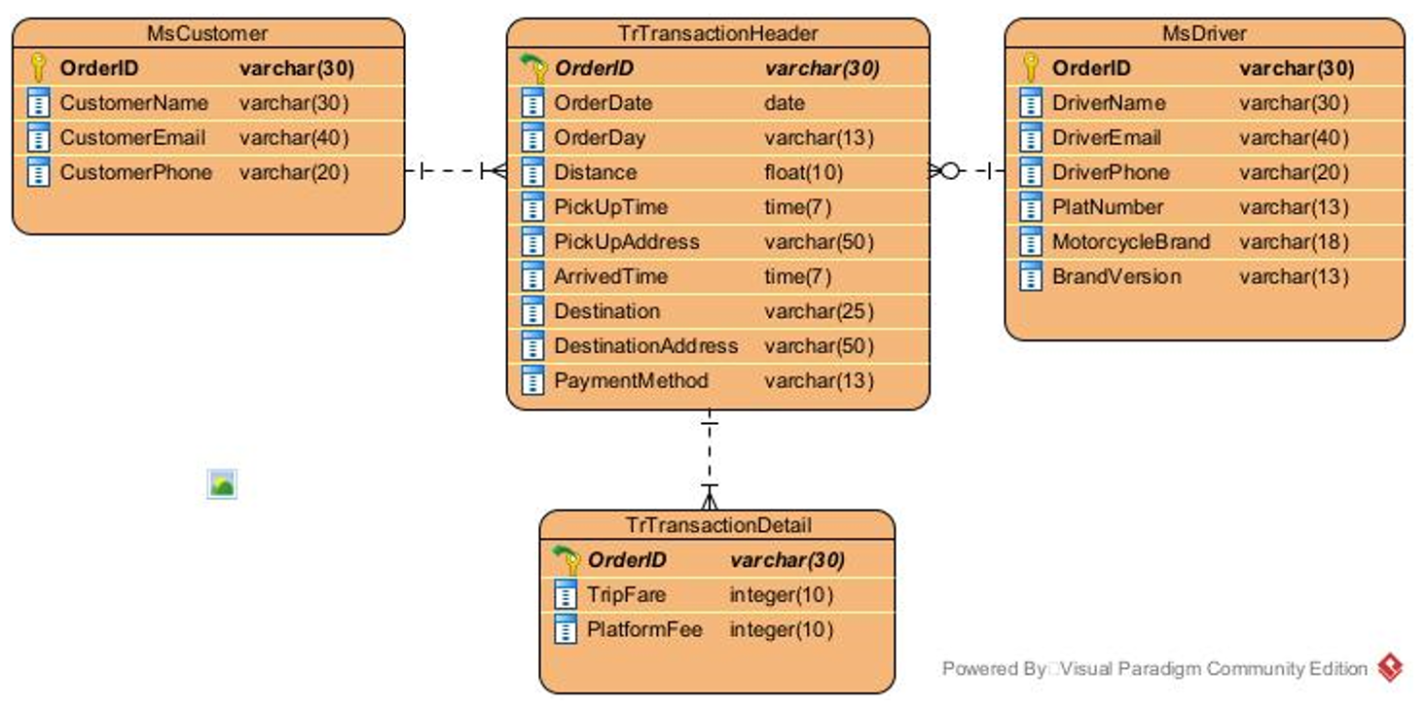
ERD
(Entity Relationship Diagram)

Slide 8


QUERY DARI STRUK YANG DIDAPAT BERDASARKAN STRUKTUR DATA YANG SUDAH FINAL

Slide 9
CREATE DATABASE Project5
CREATE TABLE TrTransactionHeader (
OrderID VARCHAR(30) PRIMARY KEY,
OrderDate DATE,
OrderDay VARCHAR(13),
Distance INT,
PickUpTime DATETIME,
PickUpAddress VARCHAR(50),
ArrivedTime DATETIME,
Destination VARCHAR(25),
DestinationAddress VARCHAR(50),
PaymentMethod VARCHAR(13)
)
CREATE TABLE trtransactionDetail (
OrderID VARCHAR(30) PRIMARY KEY,FOREIGN KEY (OrderID) REFERENCES trtransactionheader(OrderID),
TripFare INT(10),
PlatformFEE INT(10)
)

Slide 10
CREATE TABLE MsCustomer (
OrderID VARCHAR(30) PRIMARY KEY,
CustomerName VARCHAR(30),
CustomerEmail VARCHAR(40),
CustomerPhone VARCHAR(20)
)
CREATE TABLE MsDriver (
OrderID VARCHAR(30) PRIMARY KEY,
DriverName VARCHAR(30),
DriverEmail VARCHAR(40),
DriverPhone VARCHAR(20),
PlatNumber VARCHAR(13),
MotorcycleBrand VARCHAR(18),
BrandVersion VARCHAR(13)
)
ALTER TABLE trtransactionheader ADD FOREIGN KEY (OrderID) REFERENCES trtransactiondetail(OrderID);

Slide 11

QUERY REPORT LAIN YANG BISA DIDAPAT DARI STRUKTUR DATA YANG SUDAH FINAL

Slide 12
INSERT INTO `mscustomer`(`OrderID`, `CustomerName`, `CustomerEmail`, `CustomerPhone`) VALUES ('RB-162756-8335312','Fepri Putra','','')
INSERT INTO `msdriver`(`OrderID`, `DriverName`, `DriverEmail`, `DriverPhone`, `PlatNumber`, `MotorcycleBrand`, `BrandVersion`) VALUES ('RB-162756-8335312','Ahmad Sobari','','','B 4126 NIM','Honda','Vario')
INSERT INTO `trtransactionheader`
(`OrderID`, `OrderDate`, `OrderDay`, `Distance`, `PickUpTime`, `PickUpAddress`, `ArrivedTime`, `Destination`, `DestinationAddress`, `PaymentMethod`)
VALUES
('RB-162756-8335312','2022-12-22','Monday', 6.5, '2022-12-22:07:23','Jl. Mawar 3 Blok C3 No 5','2022-12-22:07:56','Stasiun MRT Lebak Bulus','Jl. Lebak Bulus Raya No.5','GoPay')
INSERT INTO `trtransactiondetail`(`OrderID`, `TripFare`, `PlatformFEE`) VALUES ('RB-162756-8335312',21000,2000);

